Slide 1

PRESENTATION BY ELLEN YAA SACKEY 28th June 2024
Fintech and Banks: Partnership or Competition?
How CAN CBG TAKE ADVANTAGE OF the New Normal

Slide 2


Consolidated Bank Ghana (CBG)
Consolidated Bank Ghana (CBG) is a state-owned commercial bank in Ghana that provides a wide range of banking and financial services to individuals and businesses. The bank has 114 branches across the country.

Slide 3
Introduction
Financial Sector Transformation
The financial industry is undergoing a significant shift driven by the rise of financial technology (fintech).
Fintech's Impact
Fintech innovations are disrupting traditional banking models and changing the way financial services are delivered.
Fintech's Impact
Fintech innovations are disrupting traditional banking models and changing the way financial services are delivered.
Key Question
Are fintech companies partners or competitors to established banks?
This presentation will explore the relationship between fintech and banks, and how Consolidated Bank Ghana (CBG) can adapt and thrive in this evolving landscape.

Slide 4
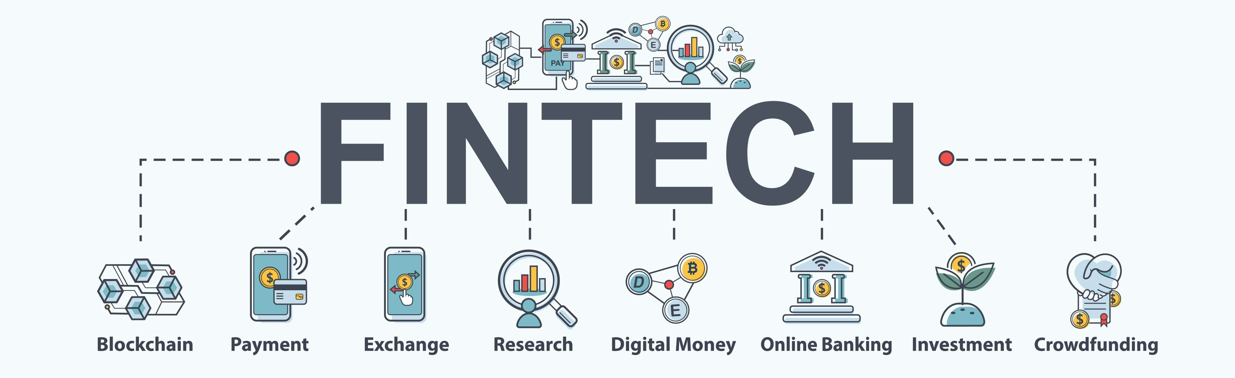
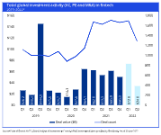

The Rise of Fintech
Fintech Definition
Global Fintech Investment
Mobile Payment Solutions
Fintech refers to technology-driven financial services and products that aim to improve and automate the delivery and use of financial services.
Global fintech investments reached $105 billion in 2020, showcasing the significant growth and investment in the fintech industry.
Innovative mobile payment solutions like M-Pesa and Apple Pay are disrupting traditional banking by providing convenient, cashless transactions.
URL: McKinsey & Company(The future of Fintech Growth

Slide 5
Opportunities for CBG
Fintech Partnerships
CBG can collaborate with fintech companies to offer innovative financial services, such as digital lending, mobile payments, and wealth management, to its existing customer base.
2. Integrated Solutions
By integrating fintech solutions into its existing banking platform, CBG can provide a seamless and enhanced customer experience, catering to the evolving digital needs of its clients.
3. Cross-Selling Opportunities
Leveraging its extensive customer base, CBG can cross-sell fintech-powered products and services, such as peer-to-peer lending, cryptocurrency trading, or robo-advisory services, to its existing clients.
4. Data-Driven Insights
By analyzing customer data and behavior patterns, CBG can work with fintech partners to develop personalized financial products and services, tailored to the specific needs of its customer segments.
5. Regulatory Compliance
CBG's existing regulatory expertise and compliance framework can help fintech partners navigate the complex regulatory landscape, ensuring the delivery of compliant and secure financial services.

Slide 6
Opportunities for CBG
Fintech Partnerships
Integrated Solutions
CBG can collaborate with fintech companies to offer innovative financial services, such as digital lending, mobile payments, and wealth management, to its existing customer base.
By integrating fintech solutions into its existing banking platform, CBG can provide a seamless and enhanced customer experience, catering to the evolving digital needs of its clients.
Data-Driven Insights
Regulatory Compliance
By analyzing customer data and behavior patterns, CBG can work with fintech partners to develop personalized financial products and services, tailored to the specific needs of its customer segments.
CBG's existing regulatory expertise and compliance framework can help fintech partners navigate the complex regulatory landscape, ensuring the delivery of compliant and secure financial services.

Slide 7
Banks and Fintech: Partnership or Competition?
Percentage of consumers using fintech services in various countries
87%
81%
72%
71%
64%
China
United States
India
United Kingdom
Ghana
URL: World Economic Forum(The rise of fintech and the growth in digital financial services

Slide 8
Strategies for Successful Partnerships
Understand the Fintech Landscape
Gain a deep understanding of the fintech ecosystem, its emerging trends, and the unique capabilities of different fintech companies. This will help you identify the right partners that complement your bank's strengths.
Establish Clear Objectives and Value Proposition
Define the specific business objectives you want to achieve through the partnership, such as improving customer experience, enhancing product offerings, or expanding reach. Clearly articulate the value proposition for both parties.
Foster Collaborative Culture
Cultivate a culture of collaboration, open communication, and mutual respect between the bank and fintech partners. Encourage cross-functional teams to work together to overcome challenges and achieve shared goals.
Align Regulatory and Compliance Requirements
Ensure that the partnership complies with all relevant banking regulations and industry standards. Collaborate to establish robust risk management frameworks and address any regulatory concerns early on.

Slide 9
Strategies for Successful Partnerships Cont.
Leverage Complementary Strengths
Identify and leverage the unique strengths of both the bank and the fintech company. The bank can provide regulatory expertise, customer base, and infrastructure, while the fintech can bring agility, innovative technologies, and customer-centric approaches.
Invest in Technology Integration
Invest in seamless technology integration between the bank's and fintech's systems to enable a frictionless customer experience. Prioritize data security, scalability, and flexibility in the integration process.
Continuously Evolve and Innovate
Establish a process for regularly reviewing the partnership, evaluating its performance, and adapting to changing market conditions and customer needs. Encourage a culture of continuous innovation and experimentation to stay ahead of the curve.

Slide 10
Conclusion
Fintech is reshaping the financial industry
The rapid growth and innovation in fintech are transforming the traditional banking landscape.
Partnership and competition present opportunities for banks
Banks can leverage fintech partnerships to access new technologies and expand their customer base, while also facing competition in certain financial services.
Continuous evolution of the fintech landscape
The fintech industry is expected to continue evolving, with further innovations and disruptions that will require banks to remain agile and adaptable.

Slide 11

THANK YOU
THANK YOU

